Slide 1

Graphics Software Development
With Vulkan
2023.08.07
Toshiba
Karthik Bala
KBVIS Technologies Pvt. Ltd.
3d@kbvis.com
Notes:
1

Slide 2
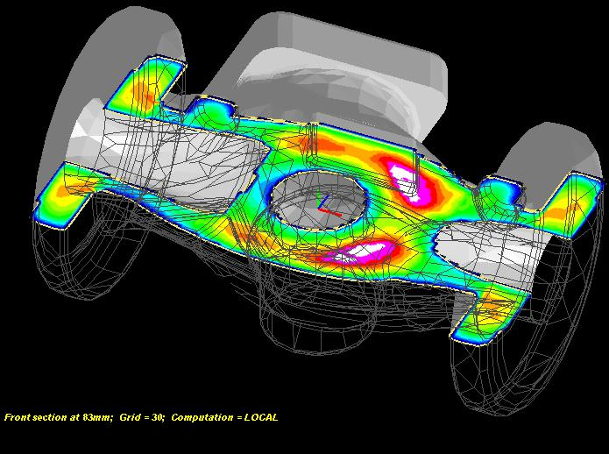
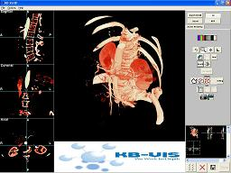
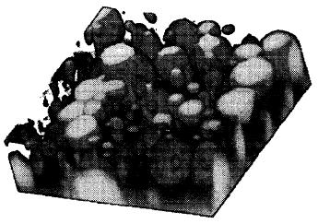

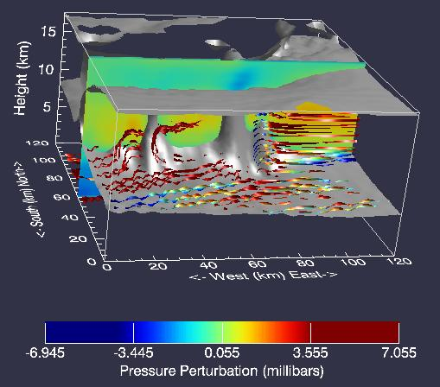
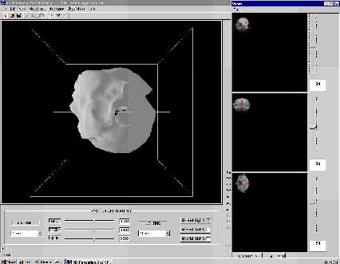
About KBVIS
Notes:
2

Slide 3
DAY 1
Notes:
3

Slide 4
Setup and Resources
Presentation Slides (will be updated progressively)
http://kbvis.com/downloads/preso.zip
WebGL Examples:
http://kbvis.com/downloads/kbvis-examples-webgl.zip
WebGL Inspector:
http://benvanik.github.io/WebGL-Inspector/
Latest version of Google Chrome:
https://www.google.com/intl/en/chrome/browser/
Launch chrome.exe with
“--allow-file-access-from-files” option to load textures and models locally. (As this undermines browser security, do NOT use this mode for browsing or deployment)
“--enable-unsafe-es3-apis” option to enable WebGL 2.0
Notes:
4

Slide 5
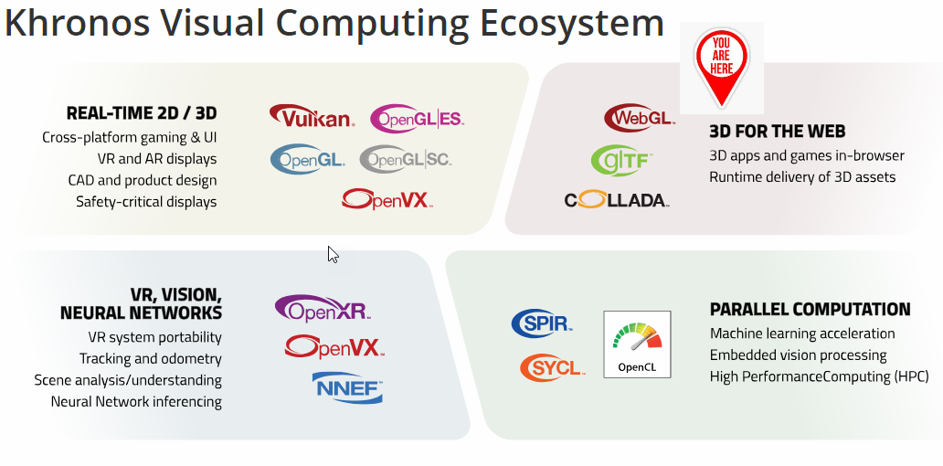
Notes:
5

Slide 6
What is OpenGL?
Software Interface to Graphics Hardware
OpenGL is a Standard
Vendors implement the API (NVIDIA, AMD etc.)
Implementations conform to core standard
Implementations have own performance characteristics and extensions
OpenGL is Low-Level
Toolkits may be built on top of OpenGL
Notes:
6

Slide 7

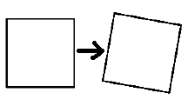
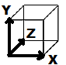
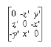
The Big Picture
To effectively use OpenGL, you need to understand:
3D Graphics Fundamentals:
3D Coordinate Systems
Transformations
Geometry
Lighting & Shading
Essential Math:
Matrix Algebra
Vector Algebra
Trigonometry, Linear Algebra, Calculus
Notes:
7

Slide 8
OpenGL Timeline
Evolved from SGI's IrisGL
1992 - Creation of OpenGL Architectural Review Board (ARB) and OpenGL 1.0
1997 – 2003 – OpenGL 1.1 – 1.5
2003 – OpenGL-ES 1.0
2004 – OpenGL 2.0
2006 – Control transferred to Khronos group
2008 - OpenGL 3.0
2010 – 2014 – OpenGL 4.0 - 4.5
2011 – WebGL 1.0
2017 – WebGL 2.0
Notes:
8

Slide 9
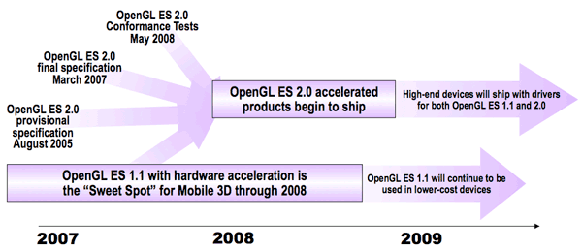
OpenGL-ES Overview
OpenGL for Embedded Systems – phones, consoles, appliances, vehicles
Lightweight API using well-defined subset profiles of desktop OpenGL
OpenGL ES 1.0 - for fixed function hardware
OpenGL ES 2.0 - programmable 3D graphics
OpenGL ES 3.0 – precision, texture improvements
Notes:
9

Slide 10
What’s not in OpenGL-ES
Features that were less popular in modern GL or that map poorly to modern hardware
Selection, Feedback, Evaluators, Display lists, Occlusion queries
Color index mode
Quad, quad strip and general polygon primitives
Texture proxies, prioritization, and residency
Vertex-wise rendering (glBegin, glEnd)
Polygon mode (the mode is always GL_FILL)
Line and polygon stippling (can be emulated)
Notes:
10

Slide 11
What is WebGL?
API for 3D Graphics on the web
WebGL 1.0 based on OpenGL-ES 2.0 (2011)
WebGL 2.0 based on OpenGL-ES 3.0 (2017)
Implemented in several browsers, including Google Chrome, Mozilla Firefox, Safari, Opera
Hardware-accelerated 3D graphics inside the browser
Exposed through HTML5 Canvas element
Runs natively in the browser - no plug-in needed

Slide 12
Hardware Acceleration
Hardware-Accelerated Rendering
Achieved using a GPU (Graphics Processing Unit)
Fast
Hardware resources are limited
Software Implementation
e.g. default Windows driver, MESA
driver may fall back to software if hardware implementation not available
Notes:
12

Slide 13
Window System
OpenGL is Platform Independent
• Need windowing system for
On-Screen Output
Opening/Closing Windows
Interaction, Handling events
• Options:
GLX (*nix)
WGL (windows)
EGL (embedded)
GLUT (window-system independent)
HTML5 Canvas (WebGL)
Notes:
13

Slide 14
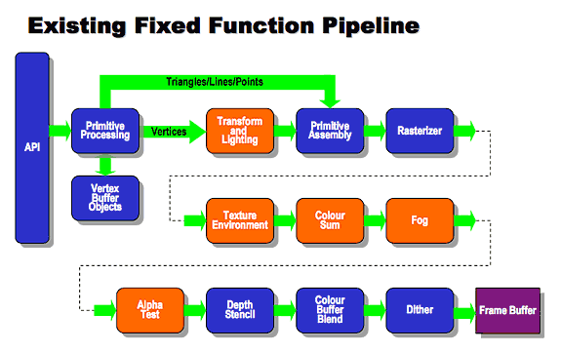
OpenGL Pipeline (Fixed-Function)
Notes:
14

Slide 15
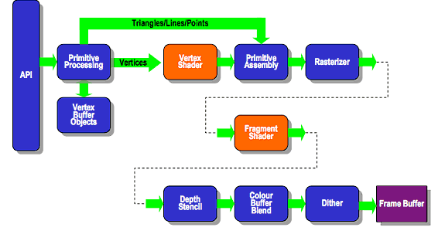
Programmable Pipeline
Notes:
15

Slide 16
Fixed vs. Programmable
Modern GPU architecture has rendered Fixed-Function pipeline obsolete
Fixed-Function
separate hardware units for T&L, Texture etc.
dedicated API calls for each function
less scalable, inflexible - functionality enhanced only by adding new API calls, parameters, or GL states
Modern GPUS
many general compute cores, massively parallel
graphics operations programmable using shaders
some functionality needs to be implemented by the programmer now (e.g. matrix transform, lighting & shading computations)
Notes:
16

Slide 17
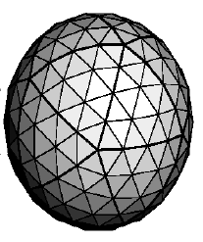
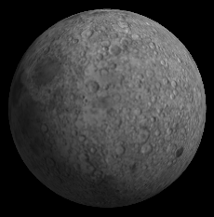
OpenGL State
OpenGL is a State Machine
2D/3D Input Data
(Vertex, Normal, Texture data)
Configure state to modify functionality
Primitive Attributes (Colour, Position, Normals)
Light Settings
Texture Data and Environment
Transform State (Rotation, Translation, Scaling)
Output to Framebuffer
(Image on/off screen)
Notes:
17

Slide 18
OpenGL Context
Stores everything associated with the current OpenGL instance (state, framebuffer etc.)
Multiple contexts possible
Only one context current at a time in a thread
OpenGL commands affect the state of whichever context is current
A single context cannot be current in multiple threads at the same time
Notes:
18

Slide 19
Creating an OpenGL Context
GLUT:
glutInit();
glutInitDisplayMode (GLUT_SINGLE | GLUT_RGB);
glutInitWindowSize (250, 250);
glutInitWindowPosition (100, 100);
glutCreateWindow ("Hello World");
WGL:
PIXELFORMATDESCRIPTOR oPixelFormatDescriptor = {
sizeof(PIXELFORMATDESCRIPTOR), 1,
PFD_DRAW_TO_WINDOW | PFD_DOUBLEBUFFER | PFD_SUPPORT_OPENGL,
PFD_TYPE_RGBA, 32, 0, 0, 0, 0, 0, 0, 0, 0, 0, 0, 0, 0, 0, 24, 0, 0,
PFD_MAIN_PLANE, 0,0, 0, 0
};
int nPixelFormat = ChoosePixelFormat(hDC, &oPixelFormatDescriptor);
DescribePixelFormat(hDC, nPixelFormat, sizeof(PIXELFORMATDESCRIPTOR),
&oPixelFormatDescriptor);
SetPixelFormat(hDC, nPixelFormat, &oPixelFormatDescriptor);
HGLRC hContext = wglCreateContext(hDC);
wglMakeCurrent(hDC, hContext);
Notes:
19

Slide 20
Getting Started – The Old Way
#include <whateverYouNeed.h>
main()
{
InitializeOpenGLWindow();
glClearColor (0.0, 0.0, 0.0, 0.0);
glClear (GL_COLOR_BUFFER_BIT);
glColor3f (1.0, 1.0, 1.0);
glOrtho(0.0, 1.0, 0.0, 1.0, -1.0, 1.0);
glBegin(GL_POLYGON);
glVertex3f (0.25, 0.25, 0.0);
glVertex3f (0.75, 0.25, 0.0);
glVertex3f (0.75, 0.75, 0.0);
glVertex3f (0.25, 0.75, 0.0);
glEnd();
}
Example 1.1 (OpenGL Red Book)
Notes:
20

Slide 21
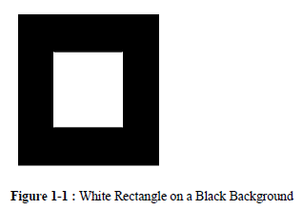
Notes:
21

Slide 22
WebGL Context
rapiscanViewer.prototype.initialize = function () {
this.canvas = document.createElement("canvas");
this.canvas.width = this.screenDim;
this.canvas.height = this.screenDim;
this.context = this.canvas.getContext('webgl2’, { antialias: true });
this.context.viewportWidth = this.canvas.width;
this.context.viewportHeight = this.canvas.height;
this.initGraphics(this.context);
};

Slide 23
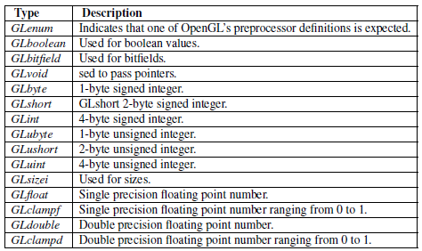
OpenGL Types
Notes:
23

Slide 24
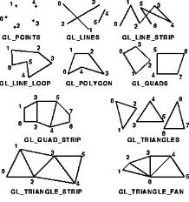
Drawing Primitives
Old Fixed-Function API:
glBegin(GL_PRIMITIVE);
glVertex(x0,y0,z0);
glVertex(x1,y1,z1);
...
glEnd();
Current API:
glDrawArrays(GLenum mode, GLint first, GLsizei count);
glDrawElements(GLenum mode,GLsizei count,GLenum type,const GLvoid *indices);
QUADS, POLYGONS not supported – use TRIANGLES instead
Notes:
24

Slide 25
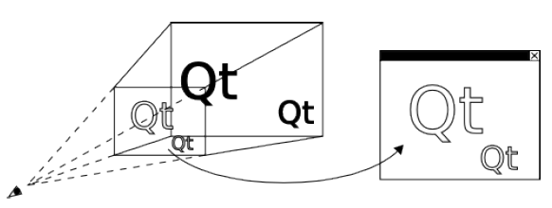
Perspective Projection
Notes:
25

Slide 26
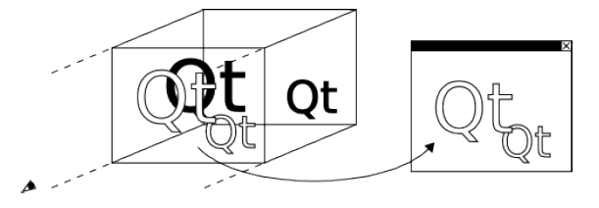
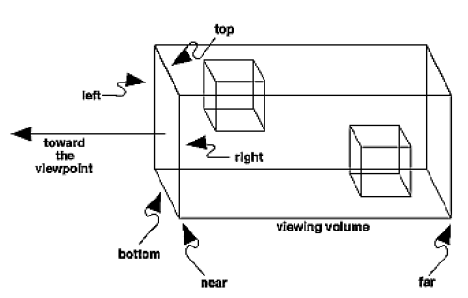
Orthographic Projection
Notes:
26

Slide 27
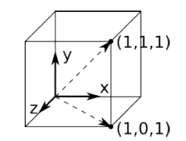
Coordinate System (Right-Handed)
v = (x,y,z)
Notes:
27

Slide 28
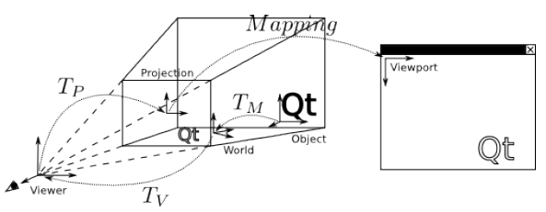
Object(3D) →View(2D) Mapping
Notes:
28

Slide 29
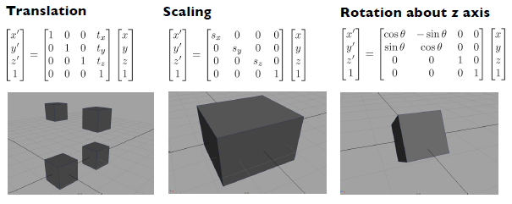
Transformations
x' = T·x
Notes:
29

Slide 30
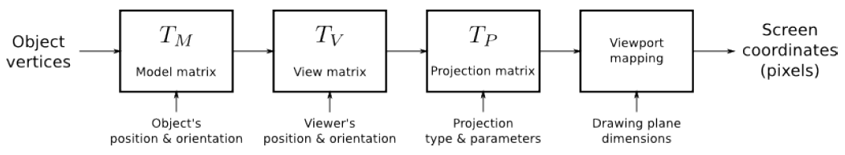
Vertex → Pixel
T = TP * TV * TM Note: multiply from the left matrix multiplication is not commutative!
Notes:
30

Slide 31
OpenGL Pipeline (Fixed-Function)
Notes:
31

Slide 32
Programmable Pipeline
Notes:
32

Slide 33
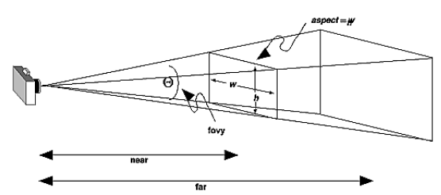
Viewport setup
function initView() {
gl.viewport(0, 0, gl.viewportWidth, gl.viewportHeight);
mat4.perspective(45, aspectRatio, 0.1, 100.0, pMatrix);
mat4.identity(mvMatrix);
setMatrixUniforms();
}
Viewport Mapping transforms Camera Coordinates (normalized) to
Window Coordinates (pixel units)
Viewport Mapping transforms Camera Coordinates (normalized) to
Window Coordinates (pixel units)
Notes:
33

Slide 34
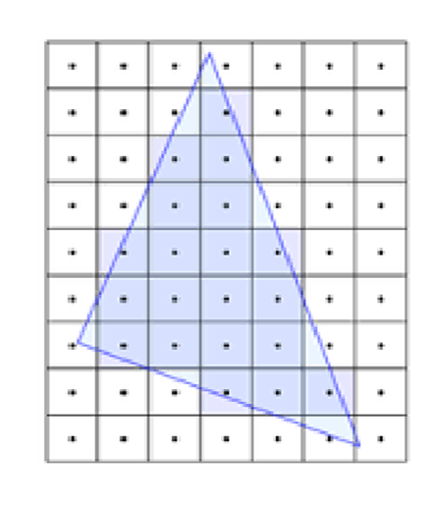
Rasterization
Frame buffer is subdivided into a grid of pixels
Determine which pixels are covered by the primitive
Fragment – data relevant to a pixel, finally resolves to a colour/output value (RGB, luminance etc.)

Slide 35
Shaders
Vertex Shader:
uniform mat4 mvpMatrix;
in vec4 vertex;
in vec4 color;
out vec4 varyingColor;
void main(void)
{
varyingColor = color;
gl_Position = mvpMatrix * vertex;
}
Fragment Shader:
in vec4 varyingColor;
out vec4 fragColor;
void main(void)
{
fragColor = varyingColor;
}
Notes:
35

Slide 36
WebGL Setup
WebGL Examples:
http://kbvis.com/downloads/kbvis-examples-webgl.zip
WebGL Inspector:
http://benvanik.github.io/WebGL-Inspector/
Latest version of Google Chrome:
https://www.google.com/intl/en/chrome/browser/
Launch chrome.exe with
“--allow-file-access-from-files” option to load textures and models locally. (As this undermines browser security, do NOT use this mode for browsing or deployment)
“--enable-unsafe-es3-apis” option to enable WebGL 2.0
Notes:
36

Slide 37
DAY 2
Notes:
37

Slide 38
Getting Started
Create a WebGL context
Implement vertex and fragment shaders
Load your shader source code through the WebGL API
Compile and link your shaders
Load your vertex data into the WebGL buffers
Use the buffers to draw your scene
Debug and troubleshoot your application
Notes:
38

Slide 39

Hello WebGL!
See examples/hello-opengl
Notes:
39

Slide 40
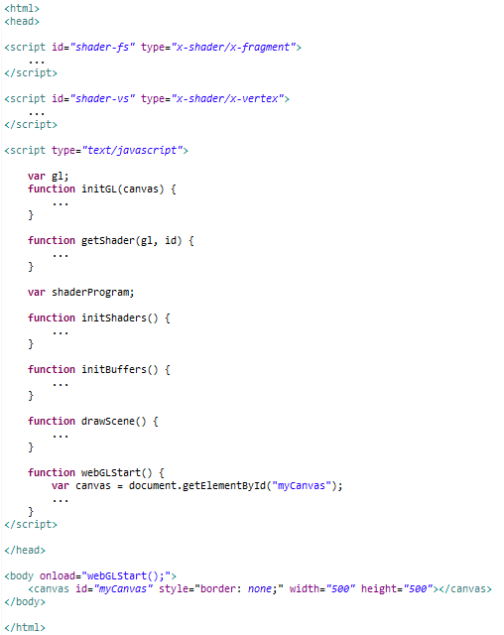
Hello WebGL - Source
Notes:
40

Slide 41
Creating the WebGL Context
<body onload="webGLStart();">
<canvas id="myCanvas" style="border: none;"
width="500" height="500"></canvas>
</body>
function webGLStart() {
var canvas = document.getElementById("myCanvas");
initGL(canvas);
initShaders();
initBuffers();
gl.clearColor(0.0, 0.0, 0.0, 1.0);
gl.enable(gl.DEPTH_TEST);
drawScene();
}
Include the <canvas> tag in the HTML code
Create a reference to your canvas so you can create a WebGLRenderingContext
The onload event is triggered when the webpage is loaded
webGLStart()is the entry point into your WebGL application
Notes:
41

Slide 42
Viewport Setup
gl.viewport(0, 0, gl.viewportWidth, gl.viewportHeight);
gl.clear(gl.COLOR_BUFFER_BIT | gl.DEPTH_BUFFER_BIT);
mat4.perspective(45, gl.viewportWidth / gl.viewportHeight, 0.1, 100.0, pMatrix);
Viewport Mapping transforms
Camera Coordinates (normalized)
to
Window Coordinates
(pixel units)
Notes:
42

Slide 43
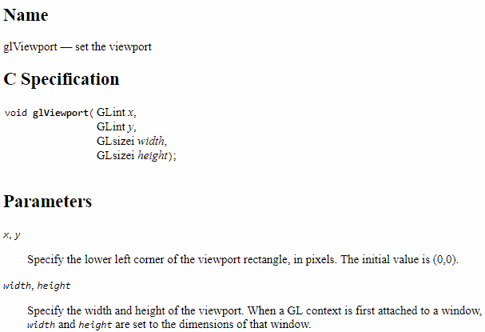
glViewport
www.khronos.org/registry/OpenGL-Refpages/

Slide 44
Creating Geometry
function initBuffers() {
triangleVertexPositionBuffer = gl.createBuffer();
gl.bindBuffer(gl.ARRAY_BUFFER, triangleVertexPositionBuffer);
var vertices = [
0.0, 1.0, 0.0,
-1.0, -1.0, 0.0,
1.0, -1.0, 0.0
];
gl.bufferData(gl.ARRAY_BUFFER, new Float32Array(vertices), gl.STATIC_DRAW);
triangleVertexPositionBuffer.itemSize = 3;
triangleVertexPositionBuffer.numItems = 3;
squareVertexPositionBuffer = gl.createBuffer();
gl.bindBuffer(gl.ARRAY_BUFFER, squareVertexPositionBuffer);
vertices = [
1.0, 1.0, 0.0,
-1.0, 1.0, 0.0,
1.0, -1.0, 0.0,
-1.0, -1.0, 0.0
];
gl.bufferData(gl.ARRAY_BUFFER, new Float32Array(vertices), gl.STATIC_DRAW);
squareVertexPositionBuffer.itemSize = 3;
squareVertexPositionBuffer.numItems = 4;
}
Create the Vertex Buffer using createBuffer()
Bind the Vertex Buffer using bindBuffer() . Subsequent buffer API calls apply to this buffer
Allocate and populate the buffer using bufferData()
Notes:
44

Slide 45

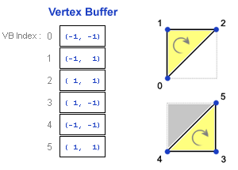
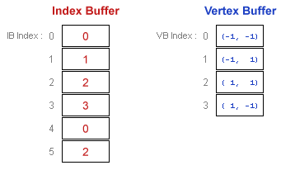
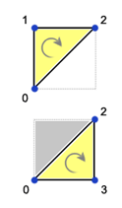
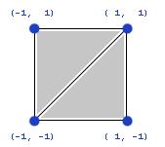
Vertex and Index Buffers
with Indexing
Notes:
45

Slide 46
Drawing the Scene
function drawScene() {
gl.viewport(0, 0, gl.viewportWidth, gl.viewportHeight);
gl.clear(gl.COLOR_BUFFER_BIT | gl.DEPTH_BUFFER_BIT);
mat4.perspective(45, gl.viewportWidth / gl.viewportHeight, 0.1, 100.0, pMatrix);
mat4.identity(mvMatrix);
mat4.translate(mvMatrix, [-1.5, 0.0, -7.0]);
gl.bindBuffer(gl.ARRAY_BUFFER, triangleVertexPositionBuffer);
gl.vertexAttribPointer(shaderProgram.vertexPositionAttribute,
triangleVertexPositionBuffer.itemSize, gl.FLOAT, false, 0, 0);
setMatrixUniforms();
gl.drawArrays(gl.TRIANGLES, 0, triangleVertexPositionBuffer.numItems);
mat4.translate(mvMatrix, [3.0, 0.0, 0.0]);
gl.bindBuffer(gl.ARRAY_BUFFER, squareVertexPositionBuffer);
gl.vertexAttribPointer(shaderProgram.vertexPositionAttribute,
squareVertexPositionBuffer.itemSize, gl.FLOAT, false, 0, 0);
setMatrixUniforms();
gl.drawArrays(gl.TRIANGLE_STRIP, 0, squareVertexPositionBuffer.numItems);
}
Specify the viewport using viewport()
Bind the vertex buffer, and link the shader vertex attribute to the buffer data using vertexAttribPointer()
Draw the vertex arrays using drawArrays()
Notes:
46

Slide 47
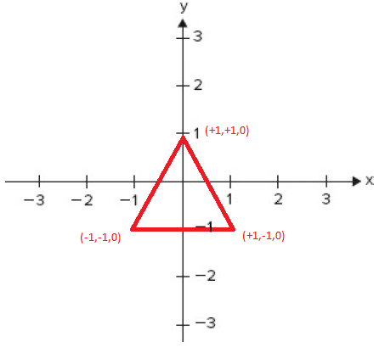
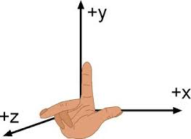
Positioning Objects
mat4.identity(mvMatrix);
mat4.translate(mvMatrix, [-1.5, 0.0, -7.0]);
...
setMatrixUniforms();
Right Handed Coordinate System
Notes:
47

Slide 48
Drawing Vertices
gl.drawArrays( mode, first, count );
render geometric primitives from bound and enabled vertex data
mode [in] – type of primitives to render - gl.LINE_STRIP, gl.LINES, gl.POINTS, gl.TRIANGLE_STRIP, or gl.TRIANGLES
first [in] - starting index in the enabled array
count [in] - number of indices to be rendered
gl.drawElements( mode, count, type, offset );
renders geometric primitives indexed by element array data
mode [in] – type of primitives to render. gl.LINE_STRIP, gl.LINES, gl.POINTS, gl.TRIANGLE_STRIP, or gl.TRIANGLES
count - number of indices to be rendered
type [in] - type of elements. Must be gl.UNSIGNED_SHORT
offset [in] - Offset into element array buffer
Notes:
48

Slide 49
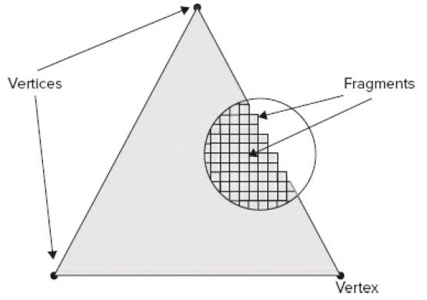
Vertex and Fragment Shaders
<script id="shader-vs" type="x-shader/x-vertex">
attribute vec3 aVertexPosition;
uniform mat4 uMVMatrix;
uniform mat4 uPMatrix;
void main(void) {
gl_Position = uPMatrix * uMVMatrix * vec4(aVertexPosition, 1.0);
}
</script>
<script id="shader-fs" type="x-shader/x-fragment">
precision mediump float;
void main(void) {
gl_FragColor = vec4(1.0, 1.0, 1.0, 1.0);
}
</script>
Vertex Shader – uses vertex attributes, transformation state, uniforms (global constant data) to compute vertex position and other values (normals, lighting values etc.)
Fragment Shader – uses vertex data from the vertex shader (interpolated across fragments) and uniforms to compute the final colour of a fragment
Computed values from the vertex shader are passed to the fragment shader via varying variables
Notes:
49

Slide 50
Buffer Objects
Transferring vertex data to GPU for every draw is inefficient
VBOs are arrays of vertex data on the GPU
PBOs are used to perform pixel transfers
After allocation, buffers may be read and written to
gl.bufferData - creates and initializes a buffer object's data store
gl.bindBuffer - bind a buffer object for use
Notes:
50

Slide 51
VBO
Vertex Buffer Object - source for vertex array data
gl.vertexAttribPointer - define an array of generic vertex attribute data, tell OpenGL programmable pipeline how to locate vertex position data
gl.drawArrays - render vertices from array data
gl.drawElements - specify vertices by using array of indices from an Index Buffer, avoid duplicating repeated vertices
Notes:
51

Slide 52
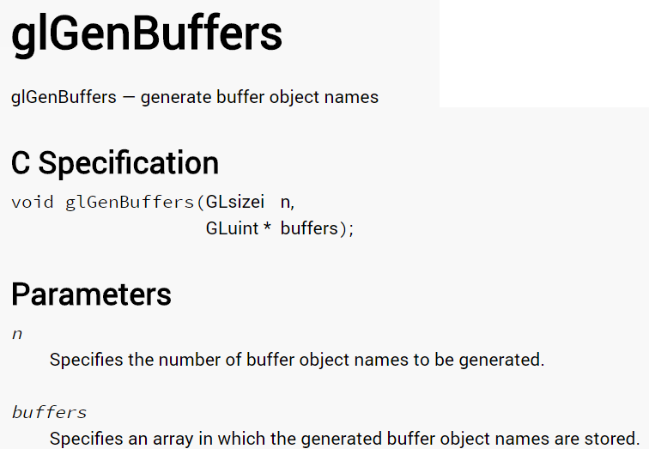
http://docs.gl/gl3/glGenBuffers

Slide 53
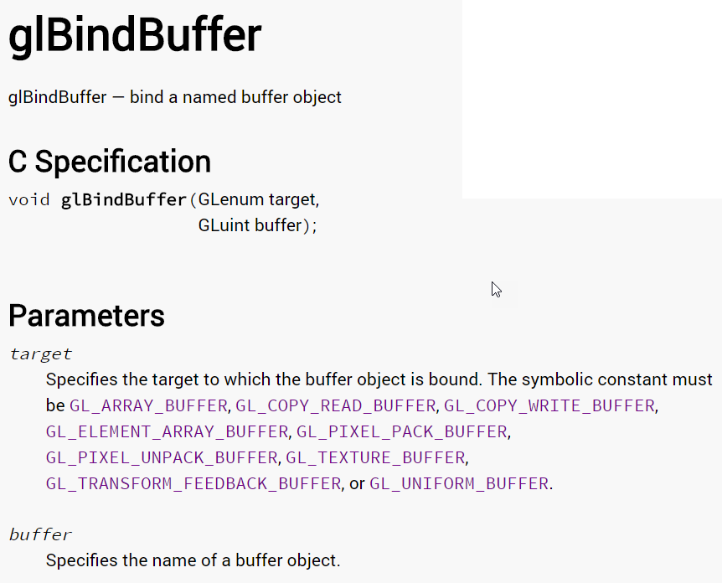
http://docs.gl/gl3/glBindBuffer

Slide 54
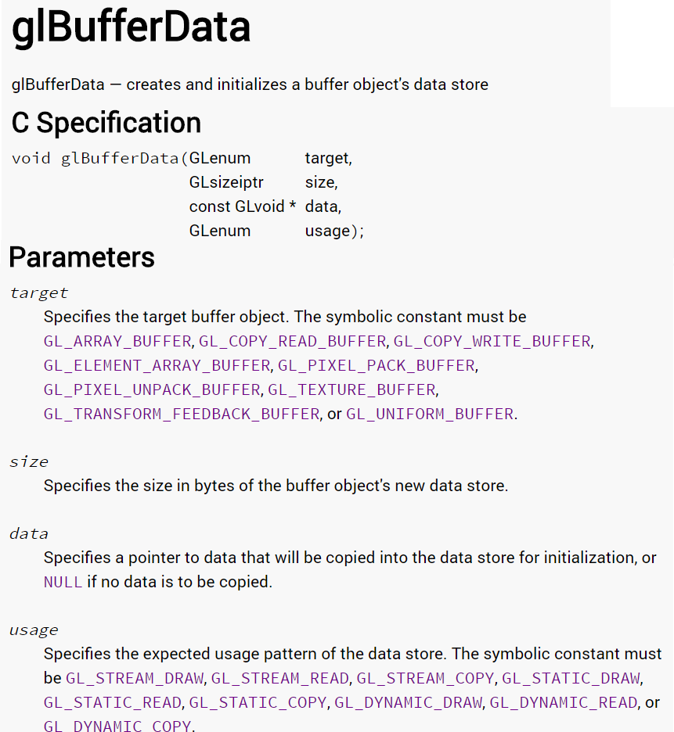
http://docs.gl/gl3/glBufferData

Slide 55

Exercise 1.1
Centre the triangle above the square
Send your edited index.html to:
3d@kbvis.com
Notes:
55

Slide 56
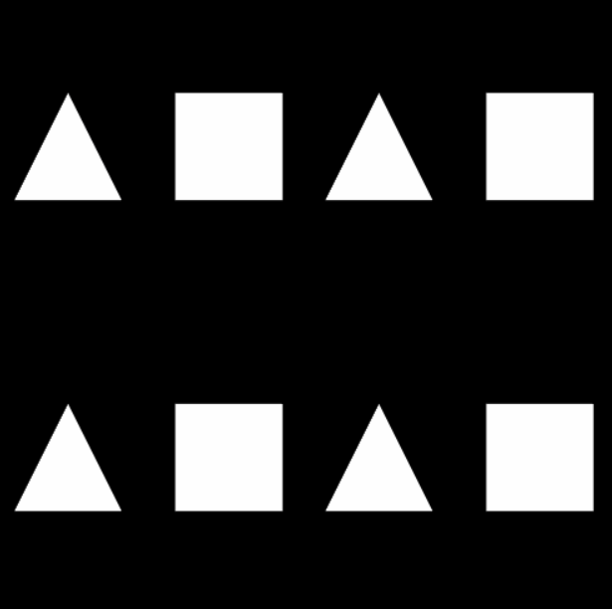
Exercise 1.2
Draw the objects four times,
in each of the four quadrants of the canvas
Send your edited index.html to:
3d@kbvis.com
Notes:
56

Slide 57
DAY 3
Notes:
57

Slide 58
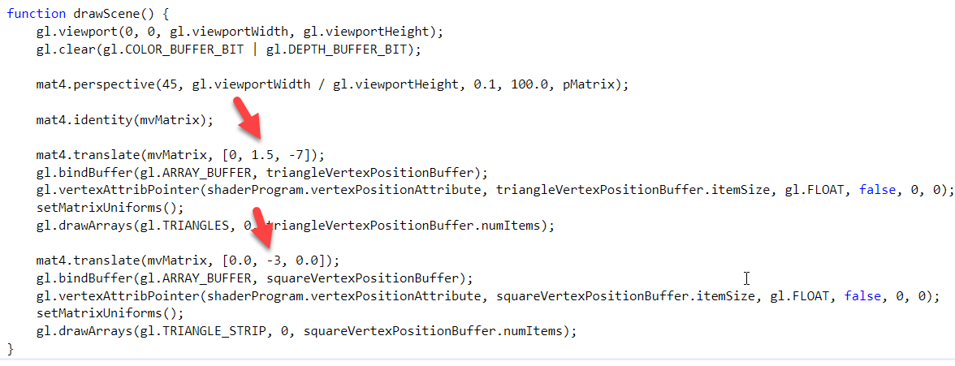
Exercise 1.1
Notes:
58

Slide 59
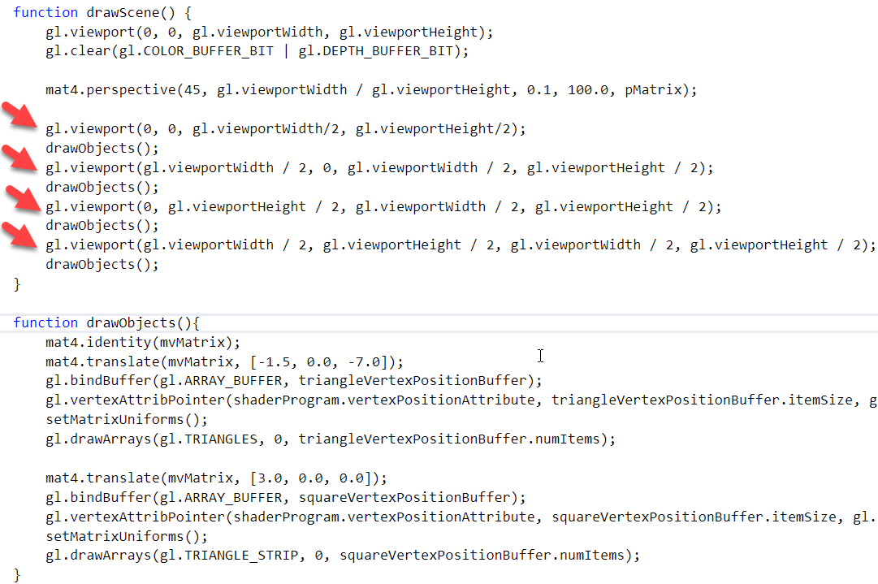
Exercise 1.2
Notes:
59

Slide 60
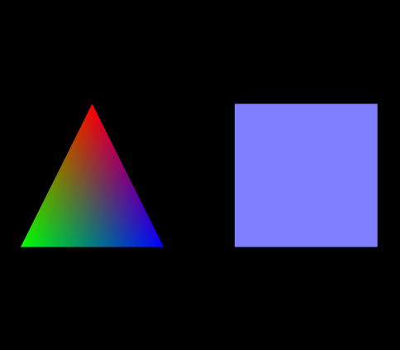
Adding Colour
See example02-colour
Notes:
60

Slide 61
Defining Colours
function initBuffers() {
...
triangleVertexColorBuffer = gl.createBuffer();
gl.bindBuffer(gl.ARRAY_BUFFER, triangleVertexColorBuffer);
var colors = [
1.0, 0.0, 0.0, 1.0,
0.0, 1.0, 0.0, 1.0,
0.0, 0.0, 1.0, 1.0,
];
gl.bufferData(gl.ARRAY_BUFFER, new Float32Array(colors), gl.STATIC_DRAW);
triangleVertexColorBuffer.itemSize = 4;
triangleVertexColorBuffer.numItems = 3;
...
squareVertexColorBuffer = gl.createBuffer();
gl.bindBuffer(gl.ARRAY_BUFFER, squareVertexColorBuffer);
colors = []
for (var i=0; i < 4; i++) {
colors = colors.concat([0.5, 0.5, 1.0, 1.0]);
}
gl.bufferData(gl.ARRAY_BUFFER, new Float32Array(colors), gl.STATIC_DRAW);
squareVertexColorBuffer.itemSize = 4;
squareVertexColorBuffer.numItems = 4;
}
Create the Colour attributes Buffer using createBuffer()
Bind the Colour Buffer using bindBuffer()
Allocate and populate the buffer using bufferData()
Notes:
61

Slide 62
Setting up Vertex Attributes
function initShaders() {
var fragmentShader = getShader(gl, "shader-fs");
var vertexShader = getShader(gl, "shader-vs");
shaderProgram = gl.createProgram();
gl.attachShader(shaderProgram, vertexShader);
gl.attachShader(shaderProgram, fragmentShader);
gl.linkProgram(shaderProgram);
if (!gl.getProgramParameter(shaderProgram, gl.LINK_STATUS)) {
alert("Could not initialise shaders");
}
gl.useProgram(shaderProgram);
shaderProgram.vertexPositionAttribute = gl.getAttribLocation(shaderProgram, "aVertexPosition");
gl.enableVertexAttribArray(shaderProgram.vertexPositionAttribute);
shaderProgram.vertexColorAttribute = gl.getAttribLocation(shaderProgram, "aVertexColor");
gl.enableVertexAttribArray(shaderProgram.vertexColorAttribute);
shaderProgram.pMatrixUniform = gl.getUniformLocation(shaderProgram, "uPMatrix");
shaderProgram.mvMatrixUniform = gl.getUniformLocation(shaderProgram, "uMVMatrix");
}
gl.getAttribLocation() - returns the “address” of the specified shader variable
gl.enableVertexAttribArray() - the values in the vertex attribute array will be accessed and used for rendering when calls are made to glDrawArrays or glDrawElements
gl.getUniformLocation() - returns the “address” of the specified shader uniform, which can then be used to set the value.
Notes:
62

Slide 63
Using Colour Attributes
function drawScene() {
...
gl.bindBuffer(gl.ARRAY_BUFFER, triangleVertexPositionBuffer);
gl.vertexAttribPointer(shaderProgram.vertexPositionAttribute,
triangleVertexPositionBuffer.itemSize, gl.FLOAT, false, 0, 0);
gl.bindBuffer(gl.ARRAY_BUFFER, triangleVertexColorBuffer);
gl.vertexAttribPointer(shaderProgram.vertexColorAttribute,
triangleVertexColorBuffer.itemSize, gl.FLOAT, false, 0, 0);
gl.drawArrays(gl.TRIANGLES, 0, triangleVertexPositionBuffer.numItems);
...
gl.bindBuffer(gl.ARRAY_BUFFER, squareVertexPositionBuffer);
gl.vertexAttribPointer(shaderProgram.vertexPositionAttribute,
squareVertexPositionBuffer.itemSize, gl.FLOAT, false, 0, 0);
gl.bindBuffer(gl.ARRAY_BUFFER, squareVertexColorBuffer);
gl.vertexAttribPointer(shaderProgram.vertexColorAttribute,
squareVertexColorBuffer.itemSize, gl.FLOAT, false, 0, 0);
gl.drawArrays(gl.TRIANGLE_STRIP, 0, squareVertexPositionBuffer.numItems);
...
}
Bind the colour buffer, and link the shader vertex attribute to the buffer data using vertexAttribPointer()
Draw the vertex arrays using drawArrays()
Notes:
63

Slide 64
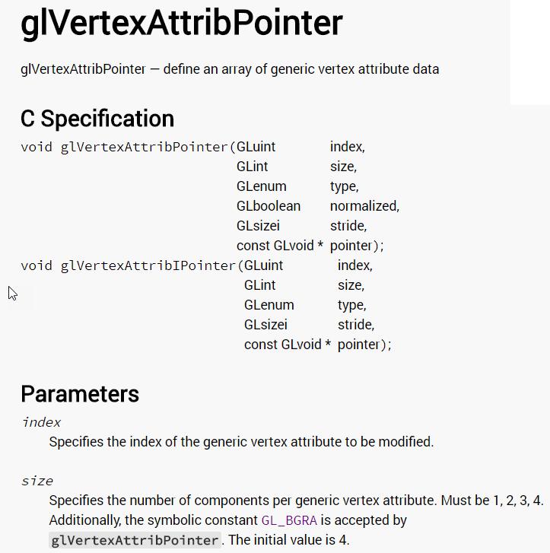

Slide 65
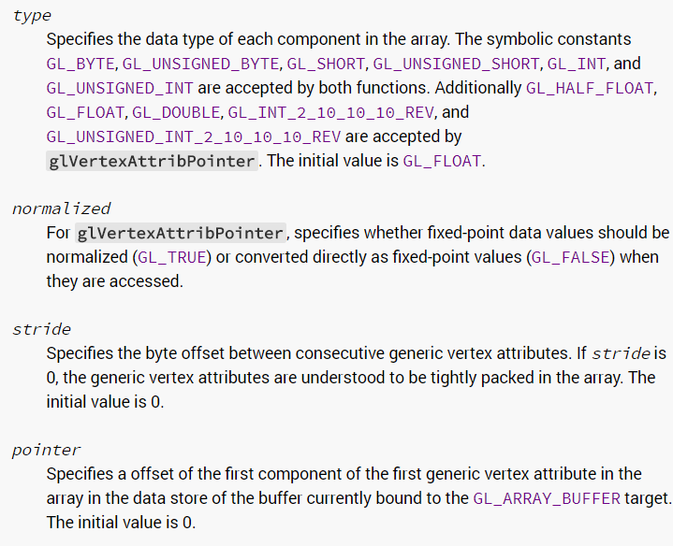

Slide 66
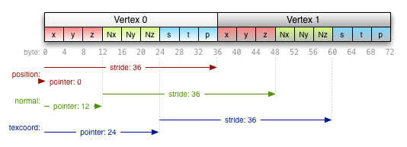

Slide 67
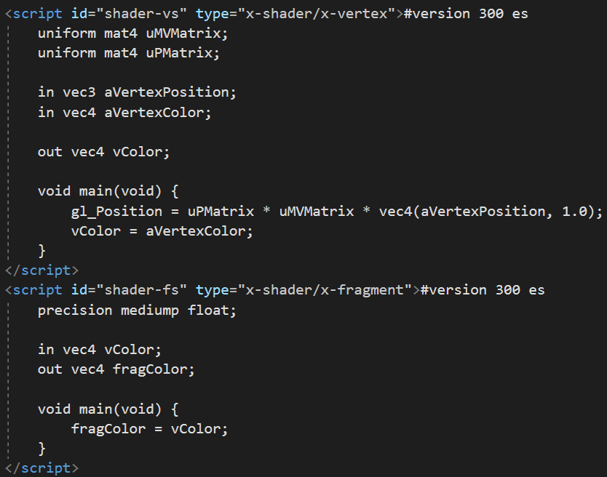
For more information on manipulating color vectors in shaders:
https://www.khronos.org/opengl/wiki/Data_Type_(GLSL)#Vectors

Slide 68
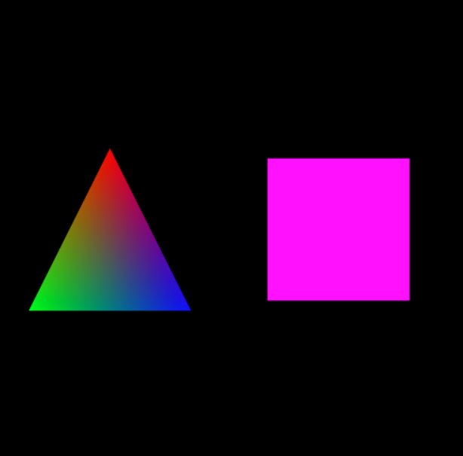
Exercise 2.1
Change the colour of the square to Magenta (RED+BLUE)

Slide 69
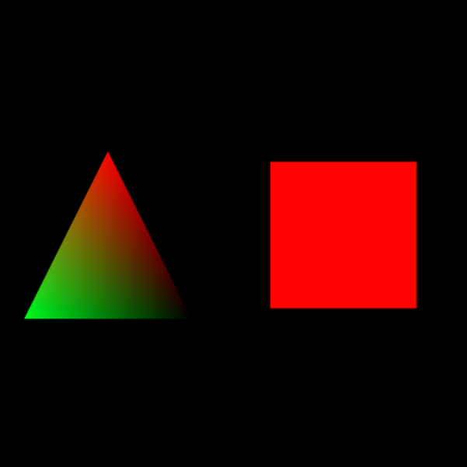
Exercise 2.2
Continuing from the previous step, change the shader to eliminate the blue component in the colour

Slide 70
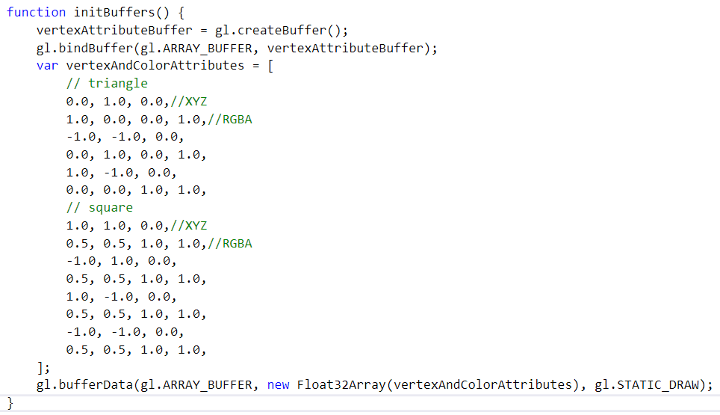
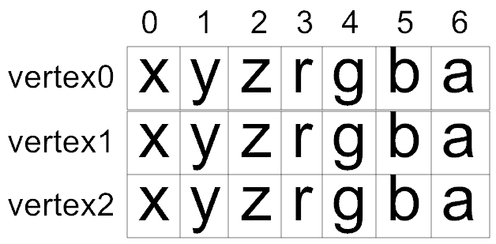
Interleaved Vertex Attributes

Slide 71


Slide 72
DAY 4
Notes:
72

Slide 73


3D Rotation
Right Hand Rule for Positive Direction of Rotation
Notes:
73

Slide 74
Transformations
x' = T·x
Notes:
74

Slide 75

3D Rotation Example
See example03-rotation
Notes:
75

Slide 76

Rotation Axes
+Y
+Y
+Y
+Y
+X
ø = rSquare
ø = rTri
Notes:
76

Slide 77
The Matrix Transforms
function drawScene() {
...
mat4.identity(mvMatrix);
mat4.translate(mvMatrix, [-1.5, 0.0, -7.0]);
// rotate the triangle
mvPushMatrix();
mat4.rotate(mvMatrix, degToRad(rTri), [0, 1, 0]);
setMatrixUniforms();
gl.drawArrays(gl.TRIANGLES, 0, triangleVertexPositionBuffer.numItems);
// roll back to previous state
mvPopMatrix();
mat4.translate(mvMatrix, [3.0, 0.0, 0.0]);
mvPushMatrix();
// rotate the square
mat4.rotate(mvMatrix, degToRad(rSquare), [1, 0, 0]);
SetMatrixUniforms();
...
gl.drawArrays(gl.TRIANGLE_STRIP, 0, squareVertexPositionBuffer.numItems);
// roll back to previous state
mvPopMatrix();
}
Notes:
77

Slide 78
Animating the Geometry
function animate() {
var timeNow = new Date().getTime();
if (lastTime != 0) {
var elapsed = timeNow - lastTime;
rTri += (90 * elapsed) / 1000.0;
rSquare += (75 * elapsed) / 1000.0;
}
lastTime = timeNow;
}
function tick() {
requestAnimFrame(tick);
drawScene();
animate();
}
function webGLStart() {
var canvas = document.getElementById("myCanvas");
initGL(canvas);
initShaders()
initBuffers();
gl.clearColor(0.0, 0.0, 0.0, 1.0);
gl.enable(gl.DEPTH_TEST);
tick();
}
Notes:
78

Slide 79
Animation Methods
handle = requestAnimationFrame( callback );
Registers a function to call when the system is ready to update (repaint) the display
Provides smoother animations and allows browsers to optimise better
Recommended over traditional setInterval() and setTimeout() methods
callback [in] - animation function to be called when system is ready
handle [out, retval] - handle to the requestAnimationFrame method that can be used to cancel the request if needed
requestAnimFrame() - wrapper from webgl-utils.js (JavaScript utilities for common WebGL tasks)
Notes:
79

Slide 80

Exercise 3.1
Change the Axis of Rotation to Z-Axis
Mail your index.html to 3d@kbvis.com

Slide 81

Moving on to 3D...
See examples/coloring folder
Notes:
81

Slide 82

3D Objects
See examples/3d-shapes
Notes:
82

Slide 83
Vertex and Index Buffers
with Indexing
Notes:
83

Slide 84
Using Vertex and Index Buffers to Define a Cube
function initBuffers() {
cubeVertexPositionBuffer = gl.createBuffer();
gl.bindBuffer(gl.ARRAY_BUFFER, cubeVertexPositionBuffer);
vertices = [
// Front face
-1.0, -1.0, 1.0,
1.0, -1.0, 1.0,
1.0, 1.0, 1.0,
-1.0, 1.0, 1.0,
// Back face
-1.0, -1.0, -1.0,
-1.0, 1.0, -1.0,
1.0, 1.0, -1.0,
1.0, -1.0, -1.0,
// Top face
-1.0, 1.0, -1.0,
-1.0, 1.0, 1.0,
1.0, 1.0, 1.0,
1.0, 1.0, -1.0,
// Bottom face
-1.0, -1.0, -1.0,
1.0, -1.0, -1.0,
1.0, -1.0, 1.0,
-1.0, -1.0, 1.0,
// Right face
1.0, -1.0, -1.0,
1.0, 1.0, -1.0,
1.0, 1.0, 1.0,
1.0, -1.0, 1.0,
// Left face
-1.0, -1.0, -1.0,
-1.0, -1.0, 1.0,
-1.0, 1.0, 1.0,
-1.0, 1.0, -1.0
];
gl.bufferData(gl.ARRAY_BUFFER, new Float32Array(vertices), gl.STATIC_DRAW);
cubeVertexPositionBuffer.itemSize = 3;
cubeVertexPositionBuffer.numItems = 24;
cubeVertexColorBuffer = gl.createBuffer();
gl.bindBuffer(gl.ARRAY_BUFFER, cubeVertexColorBuffer);
colors = [
[1.0, 0.0, 0.0, 1.0], // Front face
[1.0, 1.0, 0.0, 1.0], // Back face
[0.0, 1.0, 0.0, 1.0], // Top face
[1.0, 0.5, 0.5, 1.0], // Bottom face
[1.0, 0.0, 1.0, 1.0], // Right face
[0.0, 0.0, 1.0, 1.0] // Left face
];
var unpackedColors = [];
for (var i in colors) {
var color = colors[i];
for (var j=0; j < 4; j++) {
unpackedColors = unpackedColors.concat(color);
}
}
gl.bufferData(gl.ARRAY_BUFFER, new Float32Array(unpackedColors), gl.STATIC_DRAW);
cubeVertexColorBuffer.itemSize = 4;
cubeVertexColorBuffer.numItems = 24;
cubeVertexIndexBuffer = gl.createBuffer();
gl.bindBuffer(gl.ELEMENT_ARRAY_BUFFER, cubeVertexIndexBuffer);
var cubeVertexIndices = [
0, 1, 2, 0, 2, 3, // Front face
4, 5, 6, 4, 6, 7, // Back face
8, 9, 10, 8, 10, 11, // Top face
12, 13, 14, 12, 14, 15, // Bottom face
16, 17, 18, 16, 18, 19, // Right face
20, 21, 22, 20, 22, 23 // Left face
];
gl.bufferData(gl.ELEMENT_ARRAY_BUFFER, new Uint16Array(cubeVertexIndices), gl.STATIC_DRAW);
cubeVertexIndexBuffer.itemSize = 1;
cubeVertexIndexBuffer.numItems = 36;
}
Define cube geometry by indexing into vertex buffer
Index of shared vertex repeated, not the (x,y,z) position
Specify cube vertices
Vertices are not shared across faces, as colours are different
Notes:
84

Slide 85
DAY 5
Notes:
85

Slide 86

OpenGL Shading Language (GLSL)
GLSL is very similar to C
Source code sent to GPU as a string
Shader gets compiled and linked
GLSL Types:
Notes:
86

Slide 87
Before GLSL
void KB_VolumeRenderer::CreateAtiShader()
{
m_unShader3D = glGenFragmentShadersATI(1);
glBindFragmentShaderATI(m_unShader3D);
glBeginFragmentShaderATI();
glSampleMapATI(GL_REG_0_ATI, GL_TEXTURE0_ARB, GL_SWIZZLE_STR_ATI);
glColorFragmentOp1ATI(GL_MOV_ATI, GL_REG_1_ATI, GL_NONE, GL_NONE, GL_REG_0_ATI,
GL_NONE, GL_NONE);
glSampleMapATI(GL_REG_1_ATI, GL_REG_1_ATI, GL_SWIZZLE_STR_ATI);
glColorFragmentOp1ATI(GL_MOV_ATI, GL_REG_0_ATI, GL_NONE, GL_NONE, GL_REG_1_ATI,
GL_NONE, GL_NONE);
glEndFragmentShaderATI();
}
UGLY! – like writing assembly code

Slide 88

OpenGL and GLSL
In OpenGL 3.3+ version number is the same
https://www.khronos.org/registry/OpenGL/specs/gl/

Slide 89
GLSL Qualifiers
in – input to the shader stage
attribute - linkage between a vertex shader and OpenGL for per-vertex data. Deprecated, now same as in variables.
uniform - linkage between a shader and OpenGL for per-render data
varying - linkage between the vertex shader and the fragment shader for interpolated data. Deprecated, now same as in/out variables.
out variable of the vertex shader needs to match in variable of the fragment shader
Built-in Variables:
vec4 gl_Position - vertex shader needs to set this variable to the computed position
vec4 gl_FragColor - defines fragment’s RGBA color that will eventually be written to the frame buffer, set by the fragment shader. Post GLSL 130 output fragments may be user-specified
Notes:
89

Slide 90

GLSL Uniforms
https://www.khronos.org/opengl/wiki/Uniform_(GLSL)
Notes:
90

Slide 91
Migrating to WebGL2
Call canvas.getContext("webgl2") instead of “webgl1”
No “experimental” context anymore
Switch to GLSL 300 es
Add “#version 300 es” right at the beginning of your shaders
Replace “attribute” with “in”
Replace “varying” with “in” or “out”
Replace “gl_FragColor” with your own output color
https://www.khronos.org/opengl/wiki/OpenGL_Shading_Language

Slide 92

Example 04 – WebGL2 Version
Notes:
92

Slide 93

Example 04 – WebGL2 Version
Notes:
93

Slide 94
Interpolation qualifiers
Interpolation qualifiers control how interpolation of values happens across a triangle or other primitive.
flat
The value will not be interpolated. The value given to the fragment shader is the value from the Provoking Vertex for that primitive.
noperspective
The value will be linearly interpolated in window-space. This is usually not what you want, but it can have its uses.
smooth
The value will be interpolated in a perspective-correct fashion. This is the default if no qualifier is present.

Slide 95
Flat Colour
See example02-colour/flat-interpolation-webgl2.html
Notes:
95

Slide 96


Depth Buffering
Brute force hardware solution to visibility ordering
Depth buffer stores distance between the viewpoint and the object occupying that pixel
if the incoming fragment is nearer, the incoming depth value replaces the one already in the depth buffer
gl.depthFunc() - sets the comparison function for the depth test (default is gl.LESS)
Notes:
96

Slide 97

Culling
gl.cullFace(mode) - indicates which triangles should be discarded (culled)
mode is either gl.FRONT, gl.BACK, or gl.FRONT_AND_BACK
culling must be enabled using gl.enable(gl.CULL_FACE)
triangles whose vertices appear in counterclockwise order on the screen are called front-facing
Notes:
97

Slide 98

Clipping
Plane Equation:
Ax + By + Cz + D = 0
(A,B,C) = plane normal vector
D = Distance from origin
Notes:
98

Slide 99

Cutaway View
Render object with clipplane enabled
Disable clipping, render wireframe, with depth-test enabled
Notes:
99

Slide 100
Fixed Function API:
void glClipPlane(plane, equation);
Example:
eqn[] = {a, b, c, d};
glClipPlane (GL_CLIP_PLANE0, eqn);
glEnable (GL_CLIP_PLANE0);
Programmable API:
in vec4 Position;
out float gl_ClipDistance[1];
uniform mat4 Projection;
uniform mat4 Modelview;
uniform mat4 ViewMatrix;
uniform mat4 ModelMatrix;
uniform vec4 ClipPlane;
void main()
{
vPosition = Position.xyz;
gl_Position = Projection * Modelview * Position;
gl_ClipDistance[0] = dot(ModelMatrix * Position,
ClipPlane);
}
Notes:
100

Slide 101


Example 04 (Clipping Added)
Clip against
XZ Plane (Y=0)
Notes:
101

Slide 102

Notes:
102

Slide 103

Exercise 4.1
Clip Cube to Prism
Mail your index.html to 3d@kbvis.com
Feel free to add any questions
Notes:
103

Slide 104



Texture Mapping
Application of images onto the model surface
Texture Coordinates – [0, 1.0]
Values < 0.0 or > 1.0 are clamped or wrapped
Multiple textures may be used
Notes:
104

Slide 105

(u,v) – (x,y,z) Mapping
Notes:
105

Slide 106
Textured Cube
See examples/texture
Notes:
106

Slide 107

Chrome – Enable File Access
"C:\Program Files (x86)\Google\Chrome\Application\chrome.exe" --allow-file-access-from-files --enable-unsafe-es3-apis
Notes:
107

Slide 108
Defining Texture Attributes
function initBuffers() {
...
cubeVertexTextureCoordBuffer = gl.createBuffer();
gl.bindBuffer(gl.ARRAY_BUFFER, cubeVertexTextureCoordBuffer);
var textureCoords = [
// Front face
0.0, 0.0,
1.0, 0.0,
1.0, 1.0,
0.0, 1.0,
// Back face
1.0, 0.0,
1.0, 1.0,
0.0, 1.0,
0.0, 0.0,
...
];
gl.bufferData(gl.ARRAY_BUFFER, new Float32Array(textureCoords), gl.STATIC_DRAW);
cubeVertexTextureCoordBuffer.itemSize = 2;
cubeVertexTextureCoordBuffer.numItems = 24;
...
}
Allocate and populate the texture coordinates vertex attribute buffer using bufferData()
Notes:
108

Slide 109
Texture Coordinates
(-1.0,1.0,1.0)
(1.0,1.0,1.0)
(0,1)
(1,1)
(-1.0,-1.0,1.0)
(1.0,-1.0,1.0)
(0,0)
(1,0)
Vertex Coordinates
Texture Coordinates

Slide 110
Loading the Texture
function handleLoadedTexture(texture) {
gl.bindTexture(gl.TEXTURE_2D, texture);
gl.pixelStorei(gl.UNPACK_FLIP_Y_WEBGL, true);
gl.texImage2D(gl.TEXTURE_2D, 0, gl.RGBA, gl.RGBA, gl.UNSIGNED_BYTE, texture.image);
gl.texParameteri(gl.TEXTURE_2D, gl.TEXTURE_MAG_FILTER, gl.NEAREST);
gl.texParameteri(gl.TEXTURE_2D, gl.TEXTURE_MIN_FILTER, gl.NEAREST);
gl.bindTexture(gl.TEXTURE_2D, null);
}
void texImage2D(GLenum target, GLint level, GLenum internalformat, GLenum format, GLenum type, HTMLImageElement image)
used to load texture data
void texParameter(GLenum target, GLenum pname, GLint param)
used to set texture mode (repeat / clamp, filtering mode – linear / nearest)
Notes:
110

Slide 111
Shaders (WebGL 1)
<script id="shader-vs" type="x-shader/x-vertex">
attribute vec3 aVertexPosition;
attribute vec2 aTextureCoord;
uniform mat4 uMVMatrix;
uniform mat4 uPMatrix;
varying vec2 vTextureCoord;
void main(void) {
gl_Position = uPMatrix * uMVMatrix * vec4(aVertexPosition, 1.0);
vTextureCoord = aTextureCoord;
}
</script>
<script id="shader-fs" type="x-shader/x-fragment">
precision mediump float;
varying vec2 vTextureCoord;
uniform sampler2D uSampler;
void main(void) {
gl_FragColor = texture2D(uSampler, vec2(vTextureCoord.s, vTextureCoord.t));
}
</script>
The vertex attribute (aTextureCoord) is passed to the fragment shader as a varying (vTextureCoord) to be interploated across fragments
The fragment shader looks up the texture map (uniform sampler2D uSampler) using the interpolated texture coordinate in vTextureCoord
Notes:
111

Slide 112

Shaders (WebGL 2)
The vertex attribute (aTextureCoord) is passed to the fragment shader as output (vTextureCoord) to be interploated across fragments
The fragment shader looks up the texture map (uniform sampler2D uSampler) using the interpolated texture coordinate in vTextureCoord
Notes:
112

Slide 113
Enabling Texture Attributes for Drawing
function drawScene() {
...
gl.bindBuffer(gl.ARRAY_BUFFER, cubeVertexPositionBuffer);
gl.vertexAttribPointer(shaderProgram.vertexPositionAttribute,
cubeVertexPositionBuffer.itemSize, gl.FLOAT, false, 0, 0);
gl.bindBuffer(gl.ARRAY_BUFFER, cubeVertexTextureCoordBuffer);
gl.vertexAttribPointer(shaderProgram.textureCoordAttribute,
cubeVertexTextureCoordBuffer.itemSize, gl.FLOAT, false, 0, 0);
gl.activeTexture(gl.TEXTURE0);
gl.bindTexture(gl.TEXTURE_2D, myTexture);
gl.uniform1i(shaderProgram.samplerUniform, 0);
gl.bindBuffer(gl.ELEMENT_ARRAY_BUFFER, cubeVertexIndexBuffer);
setMatrixUniforms();
gl.drawElements(gl.TRIANGLES, cubeVertexIndexBuffer.numItems, gl.UNSIGNED_SHORT, 0);
}
activeTexture() — select active texture unit (you can have multiple texture units active)
Use gl.uniform1i() to set samplerUniform to the index of the texture unit (0) you want the fragment shader to use
Notes:
113

Slide 114
DAY 6
Notes:
114

Slide 115
OpenGL Texture API
glCreateTextures / glGenTextures
glBindTexture
glActiveTexture
glTexImage(1D/2D/3D)
glTexSubImage(1D/2D/3D)
glTexParameter
glDeleteTextures
See http://docs.gl/es2/

Slide 116

WebGL: gl.createTexture() returns the texture name

Slide 117


Slide 118


Slide 119

e.g. gl.texImage2D(gl.TEXTURE_2D, 0, gl.RGBA, gl.RGBA, gl.UNSIGNED_BYTE, texture.image);

Slide 120


Slide 121


Slide 122
Confused?
Textures can be many in number
e.g. we might have hundreds of bitmap images to choose from
Each texture is identified by its name (unsigned integer)
Texture Units are limited (only 8 guaranteed)
Texture Unit (TU/TMU/TPU) - hardware component in a GPU that does sampling
A Texture Unit can only be bound to a single texture
A Texture can be bound to multiple texture units
glActiveTexture specifies which TU we are dealing with
glBindTexture specifies which Texture Map we are dealing with

Slide 123
Texturing in the Shader
Sampler Uniform: used to perform texture lookup in the shader
Type 1D/2D/3D/Cube/Shadow (let’s stick to 2D for now)
e.g. uniform sampler2D uMyTextureMap;
Texture is sampled (looked up) using texture():
e.g. for a 2D texture with RGB values :
vec3 fragColor = texture(uSampler, vec2(textureCoordU, textureCoordV));

Slide 124

Image Processing: Loading an Image
See examples/hello-image
Notes:
124

Slide 125

Exercise 5.1: Red Channel
Send index.html to 3d@kbvis.com
Notes:
125

Slide 126
DAY 7
Notes:
126

Slide 127

Image Processing: Blurring
See examples/image-processing-2-blurring
Notes:
127

Slide 128


Simple Horizontal Blur
See examples/image-processing-2-blurring
Notes:
128

Slide 129


See image-processing-2-blurring/blurring-webgl2-magnified.html
Notes:
129

Slide 130


Exercise: Extend to 3x3 Blur
Send edited HTML to 3d@kbvis.com
Notes:
130

Slide 131

Image Processing: Convolution
See examples/image-processing-3-convolution
Notes:
131

Slide 132

Convolution Kernels
Convolution kernels are essentially weighted averages of pixels
Notes:
132

Slide 133


Color
RGB – Additive Model
Color
Index
palette
Notes:
133

Slide 134



Color Tables
Source image
(12 bit grayscale)
color table (4096 entries)
color index lookup:
(unsigned int) (R,G,B,A)
Notes:
134

Slide 135


Example – Indexed Color with Lookup Table (LUT)
See examples/image-processing-4-color-index
Notes:
135

Slide 136

Notes:
136

Slide 137

texelFetch
Notes:
137

Slide 138

Texture Units Revisited

Slide 139

Exercise – Replace the LUT with a Blue - Cyan - White spectrum
Send your edited HTML to 3d@kbvis.com
Notes:
139

Slide 140
DAY 8
Notes:
140

Slide 141
Updated Content
Updated slides:
http://kbvis.com/downloads/preso.zip
Updated examples:
http://kbvis.com/downloads/kbvis-examples-webgl.zip
Notes:
141

Slide 142
Exercise: Extend to 3x3 Blur
Send edited HTML to 3d@kbvis.com
Notes:
142

Slide 143


Slide 144

Streaming Texture
See examples/image-processing-scrolling

Slide 145

Update the contents of the specified sub-image of the texture

Slide 146

Updating a portion of the texture

Slide 147

Scroll in the Shader

Slide 148

Scissor Test
examples/image-processing-scissor-test

Slide 149

glScissor
To enable and disable the scissor test, call glEnable and glDisable with argument GL_SCISSOR_TEST.

Slide 150


Slide 151

Off-Screen Rendering
examples/image-processing-multiple-shaders

Slide 152
FBOs
Framebuffer Objects – used to render to off-screen targets
Can be used for post-processing effects
Render to texture
Attach images of type color, depth, stencil
glGenFramebuffers / glCreateFramebuffer
glBindFramebuffer
Notes:
152

Slide 153


Slide 154

Render To Texture
gl.framebufferTexture2D(
gl.FRAMEBUFFER, gl.COLOR_ATTACHMENT0, gl.TEXTURE_2D, texture, 0);

Slide 155


Slide 156


Slide 157
DAY 9
Notes:
157

Slide 158
Exercise – Replace the LUT with a Blue - Cyan - White spectrum
Send your edited HTML to 3d@kbvis.com
Notes:
158

Slide 159

Follow-up Exercise – Invert the LUT lookup to White => Cyan => Blue spectrum
Modify only this line in the shader:
Send your edited HTML to 3d@kbvis.com
Notes:
159

Slide 160

Exercise: Streaming Texture – Reverse Scroll Direction (Right to Left)
Send edited HTML to 3d@kbvis.com

Slide 161



Image Processing: YUV Color Space
See examples/example-yuv
Notes:
161

Slide 162


YUV Colour Planes

Slide 163


Image Processing: YUV Example
Y, U, V planes are uploaded as luminance textures (single channel)
The Y, U, V components are then combined into a RGB value by the fragment shader
See example/example-yuv
Notes:
163

Slide 164

Luminance Textures
Single channel
Used for grayscale or with colour LUT
Not needed now – can replace with GL_RED

Slide 165


Image Processing: YUV Demo
See examples/example-yuv
or
https://brion.github.io/yuv-canvas/demo.html
Notes:
165

Slide 166
OpenGL Lighting with Shaders
Shaders allow flexible, advanced models
GLSL built-in variables(compatibility profile, not in WebGL):
uniform gl_LightSourceParameters gl_LightSource[gl_MaxLights];
uniform gl_MaterialParameters gl_FrontMaterial;
uniform gl_MaterialParameters gl_BackMaterial;
GLSL Core - write your own lighting model
Directional Lights – per vertex / per-pixel
Point Lights
Spotlights
Anything else you can think of !
Notes:
166

Slide 167

Example - Lighting
(Directional Lighting, Per-Vertex Diffuse Shading)
See examples/directional-lighting
Notes:
167

Slide 168
The Vertex Shader
<script id="shader-vs" type="x-shader/x-vertex">
attribute vec3 aVertexPosition;
attribute vec3 aVertexNormal;
attribute vec2 aTextureCoord;
uniform mat4 uMVMatrix;
uniform mat4 uPMatrix;
uniform mat3 uNMatrix;
uniform vec3 uAmbientColor;
uniform vec3 uLightingDirection;
uniform vec3 uDirectionalColor;
varying vec2 vTextureCoord;
varying vec3 vLightWeighting;
void main(void) {
gl_Position = uPMatrix * uMVMatrix * vec4(aVertexPosition, 1.0);
vTextureCoord = aTextureCoord;
vec3 transformedNormal = uNMatrix * aVertexNormal;
float directionalLightWeighting = max(dot(transformedNormal, uLightingDirection), 0.0);
vLightWeighting = uAmbientColor + uDirectionalColor * directionalLightWeighting;
}
</script>
Compute the illumination at the vertex by applying the directional diffuse lighting model
Multiply the diffuse light colour by the illumination value to compute the diffuse shade
Add the ambient and diffuse values to compute the final lighting at the vertex
The lighting value at vLightWeighting (varying) is then interpolated across fragments
Notes:
168

Slide 169
The Fragment Shader
<script id="shader-fs" type="x-shader/x-fragment">
precision mediump float;
varying vec2 vTextureCoord;
varying vec3 vLightWeighting;
uniform sampler2D uSampler;
void main(void) {
vec4 textureColor = texture2D(uSampler, vec2(vTextureCoord.s, vTextureCoord.t));
gl_FragColor = vec4(textureColor.rgb * vLightWeighting, textureColor.a);
}
</script>
The shaded colour from the vertex shader is interpolated and passed into the fragment shader through vLightWeighting
The shaded colour is modulated by the texture map colour and output as the final fragment colour
Notes:
169

Slide 170
Lighting Parameters
function initShaders() {
var fragmentShader = getShader(gl, "shader-fs");
var vertexShader = getShader(gl, "shader-vs");
shaderProgram = gl.createProgram();
gl.attachShader(shaderProgram, vertexShader);
gl.attachShader(shaderProgram, fragmentShader);
gl.linkProgram(shaderProgram);
if (!gl.getProgramParameter(shaderProgram, gl.LINK_STATUS)) {
alert("Could not initialise shaders");
}
gl.useProgram(shaderProgram);
shaderProgram.vertexPositionAttribute = gl.getAttribLocation(shaderProgram, "aVertexPosition");
gl.enableVertexAttribArray(shaderProgram.vertexPositionAttribute);
shaderProgram.textureCoordAttribute = gl.getAttribLocation(shaderProgram, "aTextureCoord");
gl.enableVertexAttribArray(shaderProgram.textureCoordAttribute);
shaderProgram.vertexNormalAttribute = gl.getAttribLocation(shaderProgram, "aVertexNormal");
gl.enableVertexAttribArray(shaderProgram.vertexNormalAttribute);
shaderProgram.pMatrixUniform = gl.getUniformLocation(shaderProgram, "uPMatrix");
shaderProgram.mvMatrixUniform = gl.getUniformLocation(shaderProgram, "uMVMatrix");
shaderProgram.nMatrixUniform = gl.getUniformLocation(shaderProgram, "uNMatrix");
shaderProgram.samplerUniform = gl.getUniformLocation(shaderProgram, "uSampler");
shaderProgram.useLightingUniform = gl.getUniformLocation(shaderProgram, "uUseLighting");
shaderProgram.ambientColorUniform = gl.getUniformLocation(shaderProgram, "uAmbientColor");
shaderProgram.lightingDirectionUniform = gl.getUniformLocation(shaderProgram, "uLightingDirection");
shaderProgram.directionalColorUniform = gl.getUniformLocation(shaderProgram, "uDirectionalColor");
}
gl.getAttribLocation() - returns the “address” of the specified shader variable
gl.enableVertexAttribArray() - the values in the vertex attribute array will be accessed and used for rendering when calls are made to glDrawArrays or glDrawElements
gl.getUniformLocation() - returns the “address” of the specified shader uniform, which can then be used to set the value.
Notes:
170

Slide 171



Sphere Geometry
function initBuffers() {
var latitudeBands = 30;
var longitudeBands = 30;
var radius = 2;
var vertexPositionData = [];
var normalData = [];
var textureCoordData = [];
for (var latNumber=0; latNumber <= latitudeBands; latNumber++) {
var theta = latNumber * Math.PI / latitudeBands;
var sinTheta = Math.sin(theta);
var cosTheta = Math.cos(theta);
for (var longNumber=0; longNumber <= longitudeBands; longNumber++) {
var phi = longNumber * 2 * Math.PI / longitudeBands;
var sinPhi = Math.sin(phi);
var cosPhi = Math.cos(phi);
var x = cosPhi * sinTheta;
var y = cosTheta;
var z = sinPhi * sinTheta;
var u = 1 - (longNumber / longitudeBands);
var v = 1 - (latNumber / latitudeBands);
normalData.push(x);
normalData.push(y);
normalData.push(z);
textureCoordData.push(u);
textureCoordData.push(v);
vertexPositionData.push(radius * x);
vertexPositionData.push(radius * y);
vertexPositionData.push(radius * z);
}
}
var indexData = [];
for (var latNumber=0; latNumber < latitudeBands; latNumber++) {
for (var longNumber=0; longNumber < longitudeBands; longNumber++) {
var first = (latNumber * (longitudeBands + 1)) + longNumber;
var second = first + longitudeBands + 1;
indexData.push(first);
indexData.push(second);
indexData.push(first + 1);
indexData.push(second);
indexData.push(second + 1);
indexData.push(first + 1);
}
}
}
Notes:
171

Slide 172
Setting Shader Uniforms
function drawScene() {
...
var lighting = document.getElementById("lighting").checked;
gl.uniform1i(shaderProgram.useLightingUniform, lighting);
gl.uniform3f(
shaderProgram.ambientColorUniform,
parseFloat(document.getElementById("ambientR").value),
parseFloat(document.getElementById("ambientG").value),
parseFloat(document.getElementById("ambientB").value)
);
var lightingDirection = [
parseFloat(document.getElementById("lightDirectionX").value),
parseFloat(document.getElementById("lightDirectionY").value),
parseFloat(document.getElementById("lightDirectionZ").value)
];
var adjustedLD = vec3.create();
vec3.normalize(lightingDirection, adjustedLD);
vec3.scale(adjustedLD, -1);
gl.uniform3fv(shaderProgram.lightingDirectionUniform, adjustedLD);
gl.uniform3f(
shaderProgram.directionalColorUniform,
parseFloat(document.getElementById("directionalR").value),
parseFloat(document.getElementById("directionalG").value),
parseFloat(document.getElementById("directionalB").value)
);
glUniform — specify the value of a uniform variable for the current shader program object
gl.uniform3f() - takes 3 float arguments
gl.uniform3fv() - takes an array of 3 floats
Many other variations – see OpenGL documentation
Notes:
172

Slide 173
Draw Everything
...
mat4.identity(mvMatrix);
mat4.translate(mvMatrix, [0, 0, -6]);
mat4.multiply(mvMatrix, moonRotationMatrix);
gl.activeTexture(gl.TEXTURE0);
gl.bindTexture(gl.TEXTURE_2D, moonTexture);
gl.uniform1i(shaderProgram.samplerUniform, 0);
gl.bindBuffer(gl.ARRAY_BUFFER, moonVertexPositionBuffer);
gl.vertexAttribPointer(shaderProgram.vertexPositionAttribute,
moonVertexPositionBuffer.itemSize, gl.FLOAT, false, 0, 0);
gl.bindBuffer(gl.ARRAY_BUFFER, moonVertexTextureCoordBuffer);
gl.vertexAttribPointer(shaderProgram.textureCoordAttribute,
moonVertexTextureCoordBuffer.itemSize, gl.FLOAT, false, 0, 0);
gl.bindBuffer(gl.ARRAY_BUFFER, moonVertexNormalBuffer);
gl.vertexAttribPointer(shaderProgram.vertexNormalAttribute,
moonVertexNormalBuffer.itemSize, gl.FLOAT, false, 0, 0);
gl.bindBuffer(gl.ELEMENT_ARRAY_BUFFER, moonVertexIndexBuffer);
setMatrixUniforms();
gl.drawElements(gl.TRIANGLES, moonVertexIndexBuffer.numItems, gl.UNSIGNED_SHORT, 0);
}
Notes:
173

Slide 174

Mipmapping
Use low-res version of texture when fragment coverage is low
Mip map resolution is the “level” in GL texture API (0 is full-res)

Slide 175

Per-Fragment Lighting
(Specular Lighting, Per-Fragment Shading)
See examples/perfragment-lighting-json
Notes:
175

Slide 176
The Vertex Shader
<script id="per-fragment-lighting-vs" type="x-shader/x-vertex">
attribute vec3 aVertexPosition;
attribute vec3 aVertexNormal;
attribute vec2 aTextureCoord;
uniform mat4 uMVMatrix;
uniform mat4 uPMatrix;
uniform mat3 uNMatrix;
varying vec2 vTextureCoord;
varying vec3 vTransformedNormal;
varying vec4 vPosition;
void main(void) {
vPosition = uMVMatrix * vec4(aVertexPosition, 1.0);
gl_Position = uPMatrix * vPosition;
vTextureCoord = aTextureCoord;
vTransformedNormal = uNMatrix * aVertexNormal;
}
</script>
As usual, output the transformed vertex position and the vertex's texture coordinate
output the vertex's normal vector for use in the fragment shader
Notes:
176

Slide 177

The Fragment Shader
<script id="per-fragment-lighting-fs" type="x-shader/x-fragment">
varying vec2 vTextureCoord;
varying vec3 vTransformedNormal;
varying vec4 vPosition;
uniform float uMaterialShininess;
uniform vec3 uAmbientColor;
uniform vec3 uPointLightingLocation;
uniform vec3 uPointLightingSpecularColor;
uniform vec3 uPointLightingDiffuseColor;
uniform sampler2D uSampler;
void main(void) {
vec3 lightDirection = normalize(uPointLightingLocation - vPosition.xyz);
vec3 normal = normalize(vTransformedNormal);
vec3 eyeDirection = normalize(-vPosition.xyz);
vec3 reflectionDirection = reflect(-lightDirection, normal);
Float specularLightWeighting = pow(max(dot(reflectionDirection, eyeDirection), 0.0), uMaterialShininess);
float diffuseLightWeighting = max(dot(normal, lightDirection), 0.0);
vec3 lightWeighting = uAmbientColor
+ uPointLightingSpecularColor * specularLightWeighting
+ uPointLightingDiffuseColor * diffuseLightWeighting;
vec4 fragmentColor = texture2D(uSampler, vec2(vTextureCoord.s, vTextureCoord.t));
gl_FragColor = vec4(fragmentColor.rgb * lightWeighting, fragmentColor.a);
}
</script>
Notes:
177

Slide 178
Loading a JSON Model
function handleLoadedTeapot(teapotData) {
teapotVertexNormalBuffer = gl.createBuffer();
gl.bindBuffer(gl.ARRAY_BUFFER, teapotVertexNormalBuffer);
gl.bufferData(gl.ARRAY_BUFFER, new Float32Array(teapotData.vertexNormals), gl.STATIC_DRAW);
teapotVertexNormalBuffer.itemSize = 3;
teapotVertexNormalBuffer.numItems = teapotData.vertexNormals.length / 3;
teapotVertexTextureCoordBuffer = gl.createBuffer();
gl.bindBuffer(gl.ARRAY_BUFFER, teapotVertexTextureCoordBuffer);
gl.bufferData(gl.ARRAY_BUFFER, new Float32Array(teapotData.vertexTextureCoords), gl.STATIC_DRAW);
teapotVertexTextureCoordBuffer.itemSize = 2;
teapotVertexTextureCoordBuffer.numItems = teapotData.vertexTextureCoords.length / 2;
teapotVertexPositionBuffer = gl.createBuffer();
gl.bindBuffer(gl.ARRAY_BUFFER, teapotVertexPositionBuffer);
gl.bufferData(gl.ARRAY_BUFFER, new Float32Array(teapotData.vertexPositions), gl.STATIC_DRAW);
teapotVertexPositionBuffer.itemSize = 3;
teapotVertexPositionBuffer.numItems = teapotData.vertexPositions.length / 3;
teapotVertexIndexBuffer = gl.createBuffer();
gl.bindBuffer(gl.ELEMENT_ARRAY_BUFFER, teapotVertexIndexBuffer);
gl.bufferData(gl.ELEMENT_ARRAY_BUFFER, new Uint16Array(teapotData.indices), gl.STATIC_DRAW);
teapotVertexIndexBuffer.itemSize = 1;
teapotVertexIndexBuffer.numItems = teapotData.indices.length;
}
function loadTeapot() {
var request = new XMLHttpRequest();
request.open("GET", "Teapot.json");
request.onreadystatechange = function () {
if (request.readyState == 4) {
handleLoadedTeapot(JSON.parse(request.responseText));
}
}
request.send();
}
JSON (JavaScript Object Notation) - lightweight data-interchange format
Various utilities available to load/export/convert JSON and other data formats
Notes:
178

Slide 179
DAY 10
Notes:
179

Slide 180
Exercise – Replace the LUT with a Blue - Cyan - White spectrum
Send your edited HTML to 3d@kbvis.com
Notes:
180

Slide 181


Slide 182
Follow-up Exercise – Invert the LUT lookup to White => Cyan => Blue spectrum
Modify only this line in the shader:
Send your edited HTML to 3d@kbvis.com
Notes:
182

Slide 183


Slide 184
Exercise: Streaming Texture – Reverse Scroll Direction (Right to Left)
Send edited HTML to 3d@kbvis.com

Slide 185



Slide 186

Example: Dynamic Texture
See examples/dynamictexture
Notes:
186

Slide 187
FBOs
Framebuffer Objects – used to render to off-screen targets
Can be used for post-processing effects
Render to texture
Attach images of type color, depth, stencil
gl.createFramebuffer()
gl.bindFramebuffer()
Notes:
187

Slide 188


Dynamic Texture
Draw Laptop
body
(to screen)
Draw Box and
Sphere
(to texture)
Draw Laptop Screen
(to screen)
glBindTexture()

Slide 189
FBO Creation
function initTextureFramebuffer() {
rttFramebuffer = gl.createFramebuffer();
gl.bindFramebuffer(gl.FRAMEBUFFER, rttFramebuffer);
rttFramebuffer.width = 512;
rttFramebuffer.height = 512;
rttTexture = gl.createTexture();
gl.bindTexture(gl.TEXTURE_2D, rttTexture);
gl.texParameteri(gl.TEXTURE_2D, gl.TEXTURE_MAG_FILTER, gl.LINEAR);
gl.texParameteri(gl.TEXTURE_2D, gl.TEXTURE_MIN_FILTER, gl.LINEAR_MIPMAP_NEAREST);
gl.generateMipmap(gl.TEXTURE_2D);
gl.texImage2D(gl.TEXTURE_2D, 0, gl.RGBA, rttFramebuffer.width, rttFramebuffer.height, 0, gl.RGBA, gl.UNSIGNED_BYTE, null);
var renderbuffer = gl.createRenderbuffer();
gl.bindRenderbuffer(gl.RENDERBUFFER, renderbuffer);
gl.renderbufferStorage(gl.RENDERBUFFER, gl.DEPTH_COMPONENT16, rttFramebuffer.width, rttFramebuffer.height);
gl.framebufferTexture2D(gl.FRAMEBUFFER, gl.COLOR_ATTACHMENT0, gl.TEXTURE_2D, rttTexture, 0);
gl.framebufferRenderbuffer(gl.FRAMEBUFFER, gl.DEPTH_ATTACHMENT, gl.RENDERBUFFER, renderbuffer);
gl.bindTexture(gl.TEXTURE_2D, null);
gl.bindRenderbuffer(gl.RENDERBUFFER, null);
gl.bindFramebuffer(gl.FRAMEBUFFER, null);
}
Create a Framebuffer object
Bind it, so we render to it instead of the default on-screen framebuffer
Allocate a 2D texture that will receive the rendered output
Create a renderbuffer with storage for a 16-bit depth buffer
Attach the texture and depth buffer to the off-screen framebuffer
Notes:
189

Slide 190
Render to Texture
function drawScene() {
// render the moon-crate scene to texture (off screen FBO)
gl.bindFramebuffer(gl.FRAMEBUFFER, rttFramebuffer);
drawSceneOnLaptopScreen();
gl.bindFramebuffer(gl.FRAMEBUFFER, null);
...
// draw the laptop object
gl.bindBuffer(gl.ELEMENT_ARRAY_BUFFER, laptopVertexIndexBuffer);
gl.drawElements(gl.TRIANGLES, laptopVertexIndexBuffer.numItems, gl.UNSIGNED_SHORT, 0);
...
// draw the laptop screen, texture with the FBO content
gl.bindBuffer(gl.ARRAY_BUFFER, laptopScreenVertexPositionBuffer);
gl.vertexAttribPointer(shaderProgram.vertexPositionAttribute, laptopScreenVertexPositionBuffer.itemSize, gl.FLOAT, false, 0, 0);
gl.bindBuffer(gl.ARRAY_BUFFER, laptopScreenVertexNormalBuffer);
gl.vertexAttribPointer(shaderProgram.vertexNormalAttribute, laptopScreenVertexNormalBuffer.itemSize, gl.FLOAT, false, 0, 0);
gl.bindBuffer(gl.ARRAY_BUFFER, laptopScreenVertexTextureCoordBuffer);
gl.vertexAttribPointer(shaderProgram.textureCoordAttribute, laptopScreenVertexTextureCoordBuffer.itemSize, gl.FLOAT, false, 0, 0);
gl.activeTexture(gl.TEXTURE0);
gl.bindTexture(gl.TEXTURE_2D, rttTexture);
gl.uniform1i(shaderProgram.samplerUniform, 0);
setMatrixUniforms();
gl.drawArrays(gl.TRIANGLE_STRIP, 0, laptopScreenVertexPositionBuffer.numItems);
mvPopMatrix();
}
Notes:
190

Slide 191
DAY 11
Notes:
191

Slide 192

Transparency & Blending
Blending colors to make objects appear translucent
glEnable(GL_BLEND)
Blending function specifies how color values from a
source and a destination are combined:
glBlendFunc(GLenum sfactor, GLenum dfactor)
color values of incoming fragment (source) are combined with the color values of the corresponding currently stored pixel (destination):
Cdest = Csource * sfactor + Cdest * dfactor
Notes:
192

Slide 193

Blend Function
Notes:
193

Slide 194


Blend Function
glBlendEquation(GL_MAX)
glBlendFunc( GL_SRC_ALPHA, GL_ONE_MINUS_SRC_ALPHA)
Notes:
194

Slide 195
Blend Operations
glBlendFunc(GL_SRC_ALPHA, GL_ONE_MINUS_SRC_ALPHA)
known as the “over” operator, used to blend or composite a fragment over the one behind it
Dependent on rendering order – objects must be rendered in back-to-front order (w.r.t. eye)
Commonly used in rendering translucent or semi-transparent objects, especially in volume rendering, e.g. medical volume visualization
glBlendEquation(GL_MAX)
retains the fragment with maximum opacity (alpha)
Independent of render order
Commonly used in medical visualization to view high-intensity areas (bone, vasculature with contrast agent)
Notes:
195

Slide 196

“Over” Operator

Slide 197

Example: Blending
See: example10-transparency-and-blending
Notes:
197

Slide 198


Slide 199

Example: Transparent Stack
See: example10-transparency-and-blending
Notes:
199

Slide 200
Transparent Stack
Approximation to Volume Rendering
Draw transparent layers on top of one another
Use “over” operator for compositing fragment colors
Accumulation is highest in regions of maximum overlap (more fragments are blended)
Layers must be drawn in depth-order to get meaningful result.

Slide 201


Slide 202

Example: 3D Texture
See: example11-3d-texture
Notes:
202

Slide 203


Fragment Shader:
texCoord must be vec3

Slide 204


Sampling the 3D Texture
Use 3D texture coordinates (s,t,p) as vertex attributes
In glTexParameter use TEXTURE_WRAP_R for third texture dimension

Slide 205

Creating the 3D Texture

Slide 206

Using the 3D Texture

Slide 207

Transforming the 3D Texture Coordinate

Slide 208

Sampling the 3D Texture

Slide 209

Layout Qualifiers

Slide 210
DAY 12
Notes:
210

Slide 211




Simplified Example – Standard Slice Planes
Axial (XY)
Coronal (XZ)
Sagittal (YZ)

Slide 212


Slide 213


Slide 214



Standard Planes

Slide 215
Suggested Exercises
Add mouse move event handler to increment/decrement offset in texture coordinates (s,t,p) and observe the sampled result (textured quad)
Fill the byte array used for the volume texture with different patterns (chequered, intensity function etc.) and observe the slicing behaviour

Slide 216

Antialiasing
Old API:
glEnable(GL_BLEND);
glEnable(GL_POINT_SMOOTH);
glEnable(GL_LINE_SMOOTH);
glEnable(GL_POLYGON_SMOOTH);
glHint( GL_POLYGON_SMOOTH_HINT, GL NICEST);
Not very effective
“Seams” visible between triangles
This has been replaced by
Multisample Antialiasing (MSAA)
Just request an anti-aliased WebGL context
Notes:
216

Slide 217


Example: Antialiasing
See: example12-multisample
Notes:
217

Slide 218


Slide 219

Chrome Developer Tools
Tool Panels:
Elements
Resources
Network
Scripts
Timeline
Profiles
Audits
Console
Notes:
219

Slide 220

WebGL Inspector
Tool Panels:
Trace
Timeline
State
Textures
Buffers
Programs
Dynamic Cubemap Demo
Notes:
220

Slide 221
Recent Trends
OpenGL 3.0-3.3
Geometry Shader
Core and Compatibility Profiles
Core Profile excludes deprecated features:
Fixed-function vertex and fragment processing
Direct-mode rendering, using glBegin and glEnd
Display lists
Indexed-color rendering targets
OpenGL 4.0-4.6
Tessellation, Compute Shaders, Shader Atomics
Improved compatibility with OpenGL-ES
Sparse Textures, Bindless API
Increased Double Precision support
OpenGL-ES 3.0-3.2
Improved texturing, 32-bit shader precision
WebGL 2 – based on OpenGL-ES 3.0

Slide 222

New generation API
Direct, low-level GPU control
Faster performance, lower overhead, less latency
Portable - Cloud, desktop, console, mobile and embedded
One unified API framework for desktop, mobile, console, and embedded
Improved Multi-threading support
Command Buffers
https://www.khronos.org/vulkan-overview.pdf

Slide 223

OpenCL
Framework for executing programs on heterogeneous platforms:
Central processing units (CPUs)
Graphics processing units (GPUs)
Digital signal processors (DSPs)
Field-programmable gate arrays (FPGAs)
OpenCL runs “kernels” on available “compute devices”
Kernel execution runs on many “processing elements” (PEs) in parallel
Programming language used to write compute kernels is “OpenCL C” and is based on C99
C++ Bindings are available

Slide 224
Memory Hierarchy
OpenCL defines a four-level memory hierarchy for the compute device
Global memory: shared by all processing elements, but has high access latency
Read-only (constant) memory: smaller, low latency, writable by host CPU but not compute devices;
Local memory: shared by a group of processing elements;
Per-element private memory (registers)

Slide 225
OpenCL Programming
Program compilation and kernel objects
Managing Buffers
Kernel Programming and Design
Kernel Execution
Kernel Synchronization
Performance Tuning
Occupancy
Memory Coalescing
Bank Conflicts

Slide 226

Example: matrix-vector multiplication

Slide 227

Histogram Kernel – Initialise local histogram
Example - CLAHE

Slide 228

Histogram Kernel – Compute partial histogram
Example - CLAHE

Slide 229

Histogram Kernel – Combine partial histograms
Example - CLAHE

Slide 230

CLAHE Kernel – Equalise Histogram
Example - CLAHE

Slide 231
Resources
OpenGL SuperBible, Sellers, Wright, Haemel
OpenGL Shading Language, 3rd Edition, Randi Rost
www.opengl.org/documentation/specs/, Official OpenGL Documentation
OpenGL FAQ
OpenGL Common Mistakes
Computer Graphics: Principles and Practice, Foley, van Dam, Hughes
Mathematical Elements of Computer Graphics, Rogers, Adams
CS 410: Introduction to Computer Graphics, Colorado State University
WebGL: Up and Running, Tony Parisi, O’Reilly Press
WebGL Beginner’s Guide, Diego Cantor and Brandon Jones
http://www.songho.ca/opengl/gl_pbo.html (PBO Tutorial)
Introduction to Accelerated Computing
Notes:
231

Slide 232
Thank You !
Notes:
232

